Slide 1
The Levelling Up White Paper
Implications for the North of Tyne
HK 16.03.22
Levelling Up… what does it mean and where does it come from?
The LU White Paper – key policy headlines
Implications for the North of Tyne and wider North East
Next Steps

Slide 2
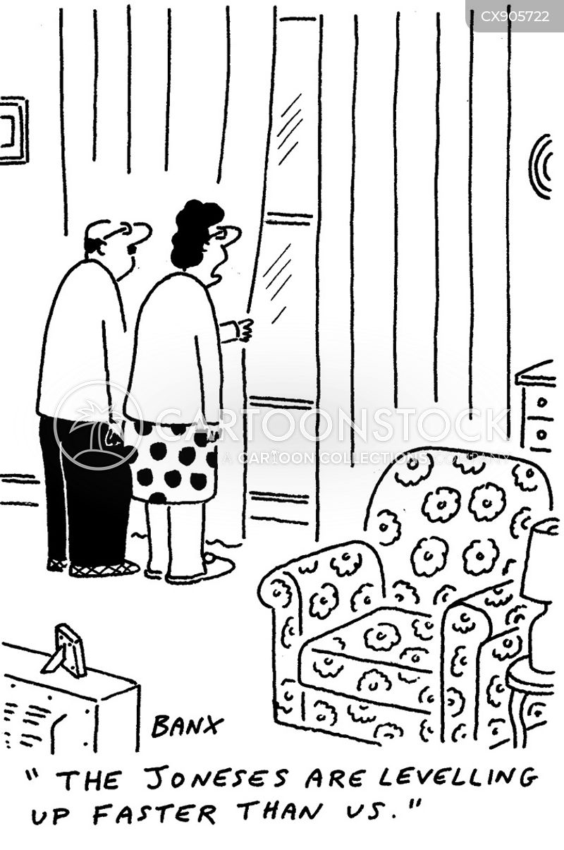
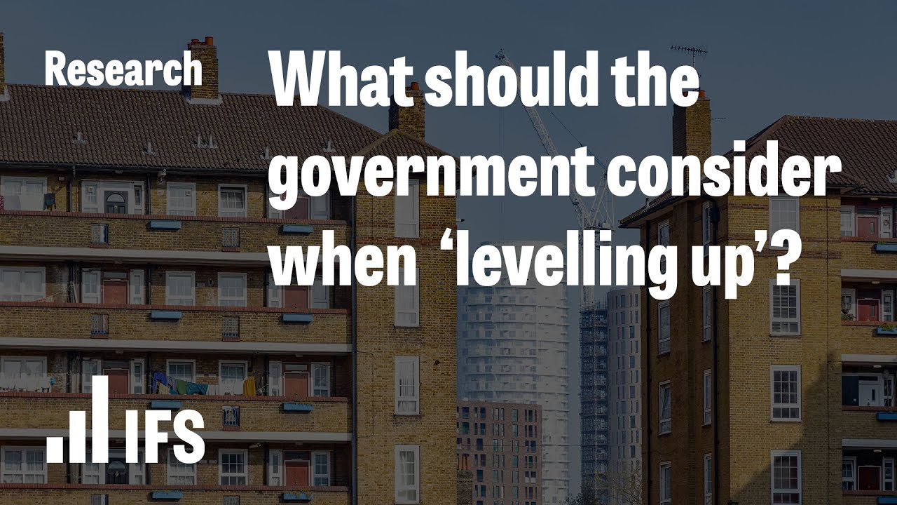
What is ‘levelling up’ and where does it come from?
A 2019 manifesto pledge and post-Brexit policy agenda
Broadly defined – from ‘pride of place’ to ‘addressing regional inequalities’ to ‘closing the productivity gap’
Driven in Govt by Michael Gove, with Neil O’Brien MP and Andy Haldane (and Lisa Nandy MP in opposition)
A mix of policy, funding and incentives – a long-term agenda which will need to cover multiple spending review periods
The start of a new phase of policy vis-a-vis the regions – on devo, local growth, public services and place
Politically important – both in terms of the current Parliamentary map, and in relation to the Union

Slide 3
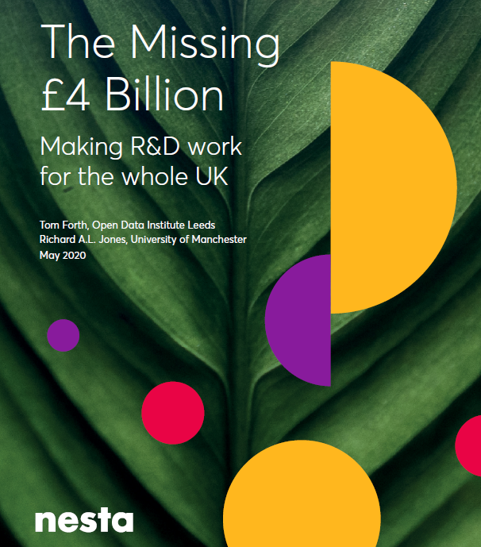
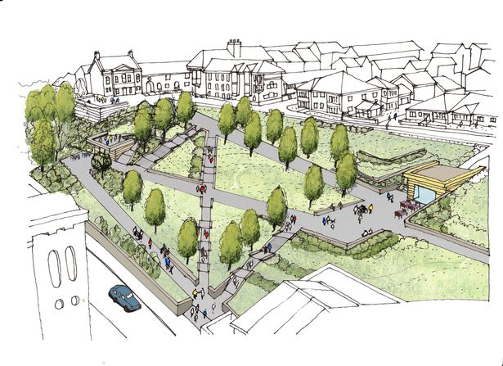
Levelling Up White Paper – the headlines
A mission for Govt disguised as a policy white paper…
Twelve long-term ‘missions’
Devolution & Local Growth
Research and Innovation
Post-EU Funding (Shared Prosperity Fund)
Skills & Adult Education
Housing and Regeneration
Long-term funding & accountability…

Slide 4
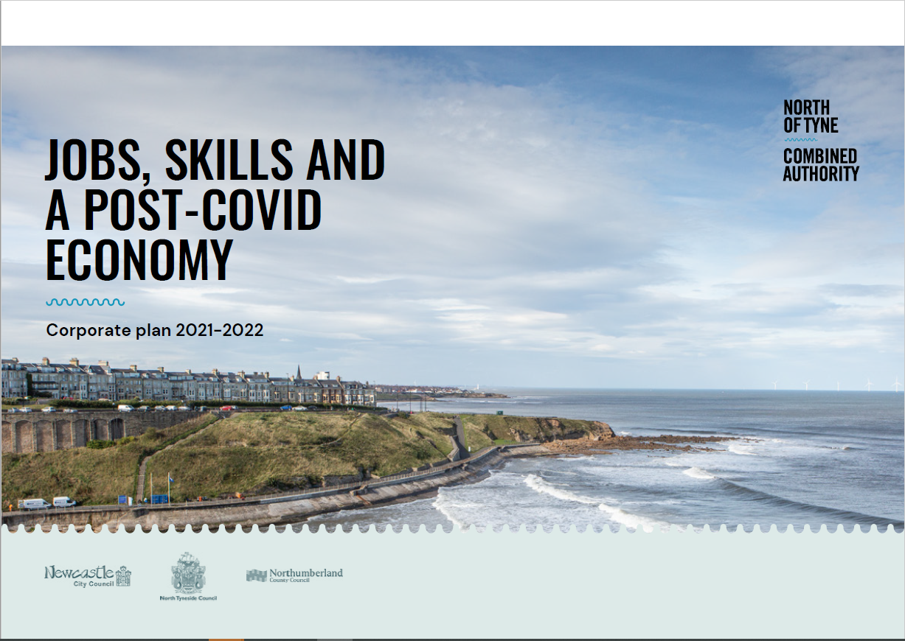
What does it mean for NTCA and the wider North East??
Devolution – support for MCAs & NE prioritised in the document
Clarity on SPF funding route (though not the amount…yet)
Additional £8m Brownfield Land fund
Skills programmes – Bootcamps & MULTIPLY – to NTCA
Clarity of Government intent on local growth policy
The opportunity to consider the next stages of devo
…and endorsement for the things we are doing!
Innovation & job creation
Inward investment – digital, BritishVolt…
Investment in skills, housing, net zero….
….and more!

Slide 5
Next Steps:
Scoping potential for a levelling up deal – Govt has signalled intent. Leaders & Mayors will want to make sure any next steps work for each place and add value.
NTCA has existing plans in place which will guide these discussions – built on our Covid Recovery plan, CSR submission and regional transport plan.
Increased funding and influence for the region via NTCA – on adult skills, housing, post-EU funding and potentially R&D.
Discussions with Whitehall colleagues ongoing on future funding streams… with the expectation of additional skills funding to ‘land’ first.
Cross-regional and cross-party collaboration continues – via NTCA Cabinet, the Joint Transport Committee and wider NE Leaders collaboration.
Meanwhile we crack on with NTCA programmes and investments!

