Slide 1
UK Community Renewal Fund (CRF) 2021-22
North of Tyne

Slide 2
Objectives of today’s session
Highlight Government’s objectives and requirements for the CRF
Outline the approach being taken by the NTCA
Discuss the 4 themes of the programme and discuss potential priorities
Explain the timetable and practical steps for bidders
Provide opportunity for questions and to hear views on opportunities for the CRF
Encourage interest in the CRF!

Slide 3
Introduction to the CRF
The £220 million UK Community Renewal Fund (UKCRF) was launched alongside the Budget
Part of wider Levelling up Agenda, and sits with the Levelling Up Fund, Community Ownership Fund and wider economic support measures
Funding will be allocated competitively
Nationally, 90% of funding is revenue and 10% capital
Successful bidders are expected to be notified in July and all delivery must be concluded by 31 March 2022
Government’s intention is:
to support communities across the UK in 2021-22 to pilot programmes and new approaches as the government moves away from the EU Structural Funds model and towards the UK Shared Prosperity Fund.
Government’s guidance is:
Lead authorities should invite project proposals from a range of local applicants, including local district councils, voluntary and community sector organisations and local education providers including universities.

Slide 4
What this means for the North of Tyne
The opportunity and approach:
NTCA is identified as the lead bidding authority for the 3 Local authority areas – total bid of up to £9m
We will follow an open process – with wide range of organisations invited to submit projects to the NTCA
Follow Government guidance around strategic fit (including national and local criteria, support net zero objectives, innovation) and deliverability (including: rapid mobilisation/delivery, risk analysis, VFM, monitoring and evaluation)
Only in very exceptional circumstances will NTCA put forward bids of less than £500,000 – in line with Government guidance to “maximise impact and deliverability through larger projects (£500,000+) where this is possible”
Interested in projects across all 4 themes: improve skills, support communities, assist business growth and recovery, and help residents into employment.

Slide 5
What this means for the North of Tyne
Our focus:
Achieve outcomes, whilst fitting with strict Government criteria – particularly deliverability
Meet NTCA priorities and investment strategy e.g. inclusive economy statement, investment strategy, Strategic Skills Plan
Avoid duplication with existing projects, unless there is evidence of unmet need or opportunity to expand benefits
Seek opportunities for CRF to fill gaps, address challenges from Covid-19 and pilot new approaches
Encourage NTCA-wide bids, unless project designed to meet specific opportunity/challenge of a place
Supportive of bidders who want to deliver a project over a wider footprint than just NTCA

Slide 6
Business
Government Examples:
NTCA priorities:
Supporting entrepreneurs and helping businesses with potential to create more job opportunities for current employees or take on new employees.
Encouraging businesses to develop their innovation potential
Supporting decarbonisation measures
Sectoral programmes – digital, ageing, culture and creative
Inward investment and supply chain development
Covid-19 recovery programmes: Capacity funding, culture and creative, innovation-recovery
Digital adoption
Business start-ups and any gaps/innovation in business support

Slide 7
Communities and Places
Government Examples:
NTCA priorities:
Feasibility studies for delivering net-zero and local energy projects
Exploring opportunity for promoting culture-led regeneration and community development
Improving green spaces and preserving important local assets
Promoting rural connectivity
Energy, Green Growth and Climate Change Blueprint
Culture & Creative Programme priorities
Recovery Deal
Recovery Innovation Fund and the role of places (urban and rural) post Covid-19

Slide 8
Investment in Skills
Government Examples:
NTCA Skills Priorities
(NoT Strategic Skills Plan 2021-23)
Work-based training
Retraining, upskilling or reskilling members of the workforce
Promoting the advancement of digital skills and inclusion
Secure better outcomes for young people
Invest in skills to support the local economy
Help people progress into work and in work
The region has a comparative advantage and strong potential in a number of sectors. These include a fast-growing tech and digital sector; research and design in low carbon energy and the offshore sector; a strong pharmaceuticals and life sciences sector; major employment in financial and professional business services; and a world-class urban and rural tourism and leisure offer.
NTCA’s recovery and growth sectors have the potential to offer employment opportunities and significant GVA growth. We have an opportunity to plan for this growth and jobs by ensuring the Combined Authority, with skills providers, including colleges and universities, are investing in the right skills provision.

Slide 9
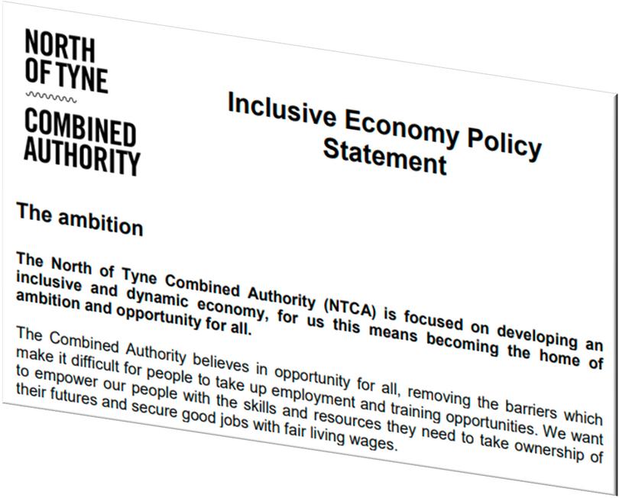
Supporting People into Employment
Government Examples:
Supporting people to engage with local services which support them on their journey towards employment
Identifying and addressing any potential barriers these individuals may face in gaining employment or moving closer to the labour market
Raising aspirations, supporting individuals to access Plan for Jobs employment support, jobs and find sustainable employment
Supporting people to gain the basic skills they need to develop their potential for sustainable work
Testing what works in helping people move towards work

Slide 10
Next Steps
Launch on 31st March 2021 on NTCA website
NTCA Invitation to Bid will be published on NTCA website and will include more details of local priorities.
Government guidance, assessment criteria and standard application form on gov.uk website
Deadline for submission to NTCA – Before midnight on Friday 7th May
Appraisal and Due Diligence process/shortlist
NTCA submission of shortlisted projects to Government by 18th June
Government announcement of successful bids late July onwards
Projects must end before March 2022

Slide 11
How Bids will be assessed?
As the lead authority, NTCA will assess all bids submitted.
Bids will be assessed against:
the gateway criteria set out in the UK Community Renewal Fund Prospectus – bids that fail to meet these criteria are ineligible support and will be rejected
the extent to which they meet the objectives of UK Community Renewal Fund
the extent to which bids would support the delivery of local growth and employment support priorities
Shortlisted projects up to £9m across NTCA area to be submitted to Government.
UK Government assesses against criteria in UK Community Renewal Fund Prospectus
Government announcement – late July onwards
Notes:
NTCA will submit those eligible bids which most strongly meet the UK Community Renewal Fund and local priorities to the UK Government for consideration, up to a maximum of £3m per place.
The UK Government will assess all bids submitted by lead authorities against the criteria set out in the UK Community Renewal Fund Prospectus.
The UK Government will announce the outcome of the assessment process from late July 2021 onwards.
NTCA will enter into a funding agreement with successful bidders.

Slide 12
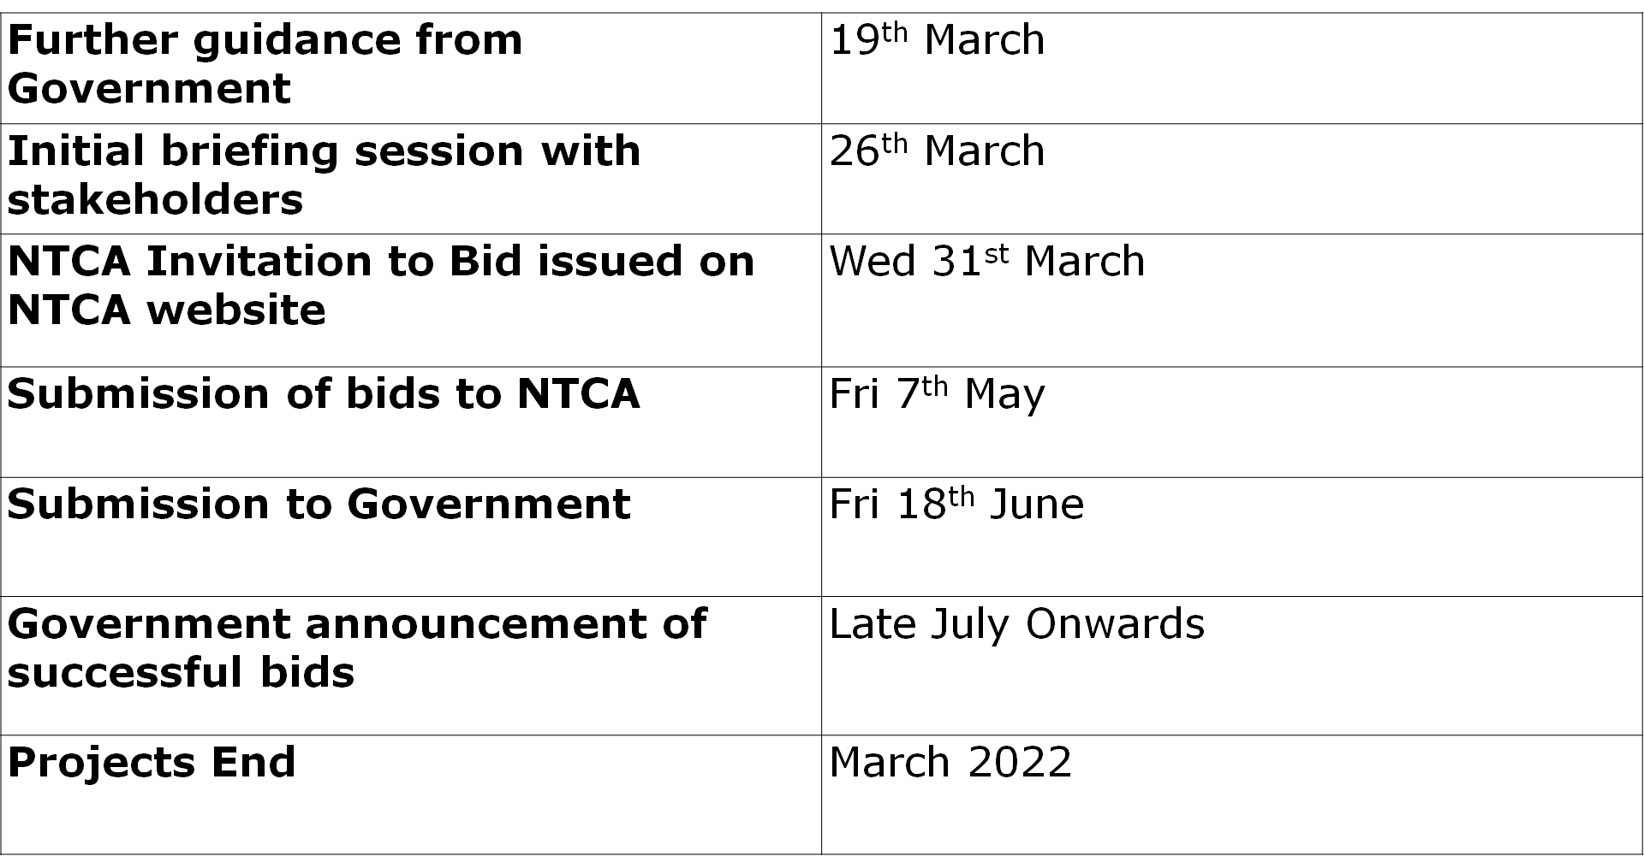
Timeline

Slide 13
Thank you for listening
Q&A
Contact: CRF@northoftyne-ca.gov.uk

